Slide 1
Leadership links with care

Slide 2
Background and purpose
I need to engage in a dialogue about what I as a leader could do to enhance my leadership approach based on what the evidence tells us
After the session, I need to record my reflections about the teaching activities and what I have learnt about how I own leadership impacts on patient care and experience

Slide 3
How leadership is linked to healthcare improvement
In 2008, Professor John Øvretveit healthcare management how leadership was linked to healthcare improvement
"No studies have rigorously tested the importance of leadership to improvement in healthcare“
“It is a long causal link from a leader's actions to outcomes“
The actions and behaviours of leaders were very difficult to directly attribute to the quality or improvement of care.

Slide 4
Team leadership
There is a growing body of evidence about the effect of leadership on the climate within a team, with subsequent impact on outcomes. Several studies have illustrated that in a public sector and healthcare context, team leadership can:
Influence up to 30% of a team's performance
Directly affect team’s actions and outcomes and therefore patient safety
Create lower stress and higher quality patient care
Impact on patient satisfaction with services
Be critical to high performance
Affect engagement of staff and team performance

Slide 5
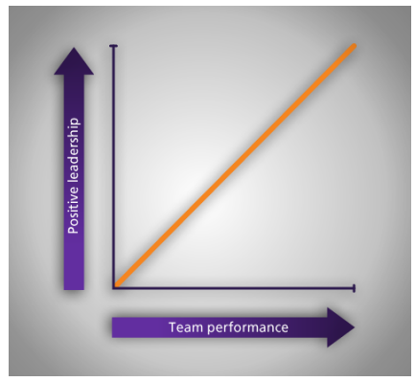
Team leadership
Can you can see how the research evidence shows that leaders can have a positive (or detrimental) impact on team performance?

Slide 6
Positive emotional environment
Doug Pugh from Virginia Commonwealth University in the USA researched the importance of recognising that providing service to others is emotional work, known as emotional labour
Leaders need to help create a climate which supports professional carers in their emotional labour and recharges their emotional bank account
A structured approach to supporting staff in their emotional labour yields genuine user/carer and patient benefits

Slide 7
Engagement
The definition of engagement, MacLeod and Clarke (2009):
"The business values the employee and the employee values the business”
Study by Marisa Salanova suggests that engaged staff are
More likely to put energy into interactions with clients
This may in turn motivate other staff
Creating a more engaged workplace
The King's Fund Report Together We Can (2012) proposes another explanation:
that "engaged staff are likely to exert more influence over the use of standard processes, teamwork and the degree to which there is a culture of improvement, all of which are factors influencing patient outcomes."

Slide 8
What leaders can do to support engagement?
Saijo Mauno found that people having control over how they did their jobs was the best predictor of engagement, even more than management quality
Jari Hakanen: Think carefully about how jobs are designed to ensure:
Sense of autonomy
Staff are involved in understanding resource availability
Self-esteem is promoted
Positive climate is created.
Manageable workload

Slide 9
Staff engagement
Doctors who are engaged are less likely to make mistakes
Safer patient care is linked to nurses feeling engaged
A lack of engagement can be a cause of poor care
Leadership behaviours were most associated with service improvement
Valuing the skills and expertise of others
Better patient experience is evident in organisations where staff engagement is higher.
Seeking, understanding and valuing the viewpoint of others
Building confidence and trust in others
Facilitating cooperation and collaboration.

Slide 10
Relationship between clinicians and managers
The quality of relationships between clinicians and managers in a healthcare organisation affects Care
Clinical innovation stems from blending clinical and managerial skillsets
Innovations are more likely to be successful if they are built on good manager-clinician relations
Partnership between clinical leaders and experienced managers is a key leadership factor

Slide 11
Conclusions
How you choose to lead can make a real difference to the impact you have on those around you and ultimately on people being cared for by our health and social care services
A curiosity to learn what works well, and why it does so underpins all good leadership practice, and this can be based on experience as well as on research findings and reading
From leadership studies and experience in healthcare: there is no 'one best way' of being an effective leader
Leadership benefits from an approach that is not uniform or universalistic, but that asks key questions: what will work, in what circumstances, why and how?"

Slide 12
Discussion and reflection
What can I do as a leader to enhance my leadership approach based on what this evidence tells us?
As a leadership team, what could we collectively do to enhance our leadership approach based on this evidence?

Slide 13

Contents
Section title 3
Section title 8
Section title 10
Section title 12
Section title 15
Section title 23
Section title 25
Section title 27
Section title 31
Section title 36
Section title 38
Section title 41

Slide 14














Our icons – blue Further icons can be downloaded from the Visual Identity hub

